Slide 1
AWS S3
(Amazon Simple Storage Service)

Slide 2
Content:
Introduction.
Steps to create S3 bucket.
Create Bucket with example.
How to Upload object (data files) to your bucket.
S3 data Accessing.
S3 Life Cycle Management.
Amazon Simple Storage Service(S3) – Versioning.
Deleting Bucket and objects.
CLI commands for S3.

Slide 3
1. Introduction
Amazon Simple Storage Service (S3) is a storage for the internet. It is designed for large-capacity, low-cost storage provision across multiple geographical regions. Amazon S3 provides developers and IT teams with Secure, Durable and Highly Scalable object storage.
1. S3 is Secure because AWS provides:
Encryption to the data that you store. It can happen in two ways:
Client Side Encryption
Server Side Encryption
Multiple copies are maintained to enable regeneration of data in case of data corruption
Versioning, wherein each edit is archived for a potential retrieval.
2. S3 is Durable because:
It regularly verifies the integrity of data stored using checksums e.g. if S3 detects there is any corruption in data, it is immediately repaired with the help of replicated data.
Even while storing or retrieving data, it checks incoming network traffic for any corrupted data packets.
3. S3 is Highly Scalable, since it automatically scales your storage according to your requirement and you only pay for the storage you use.

Slide 4
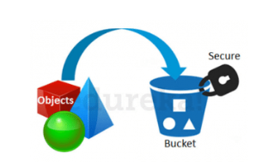
What kind and how much of data one can store in AWS S3?
You can store virtually any kind of data, in any format, in S3 and when we talk about capacity, the volume and the number of objects that we can store in S3 are unlimited.
An object is the fundamental entity in S3. It consists of data, key and metadata.
When we talk about data, it can be of two types-
Data which is to be accessed frequently.
Data which is accessed not that frequently.
Therefore, Amazon came up with 3 storage classes to provide its customers the best experience and at an affordable cost.
How is data organized in S3?
Data in S3 is organized in the form of buckets.
A Bucket is a logical unit of storage in S3.
A Bucket contains objects which contain the data and metadata.
Before adding any data in S3 the user has to create a bucket which will be used to store objects.

Slide 5
2. Steps to create S3 bucket.
Bucket Name - ( It should be unique globally )
( No uppercase )
( should not contain invalid char like ' , [ # _ )
Check bucket name restriction in google
bucket name - test-dsgdfsgdfsgdfs123
regions - mumbai
Next ---> Next --> uncheck block public access ---> Next ----> Create bucket.
Note: Buckets created are available global. Not like Ec2 machines
Observation: We can see global in dashboard.

Slide 6
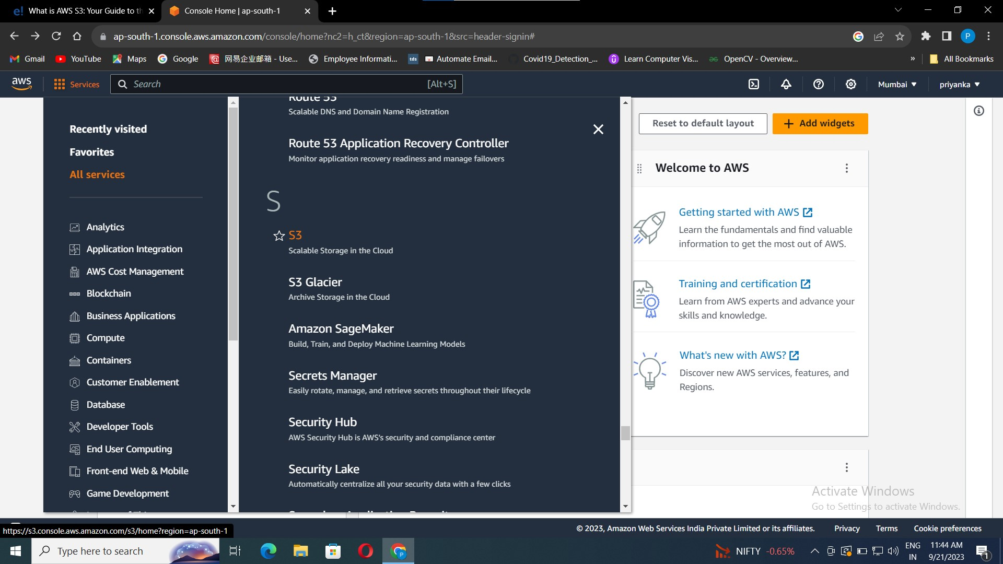
3. Create Bucket with example.
Let’s create a S3 bucket with the following steps.
Go to aws console -> services -> S3.
It will take you to the S3 Dashboard.

Slide 7
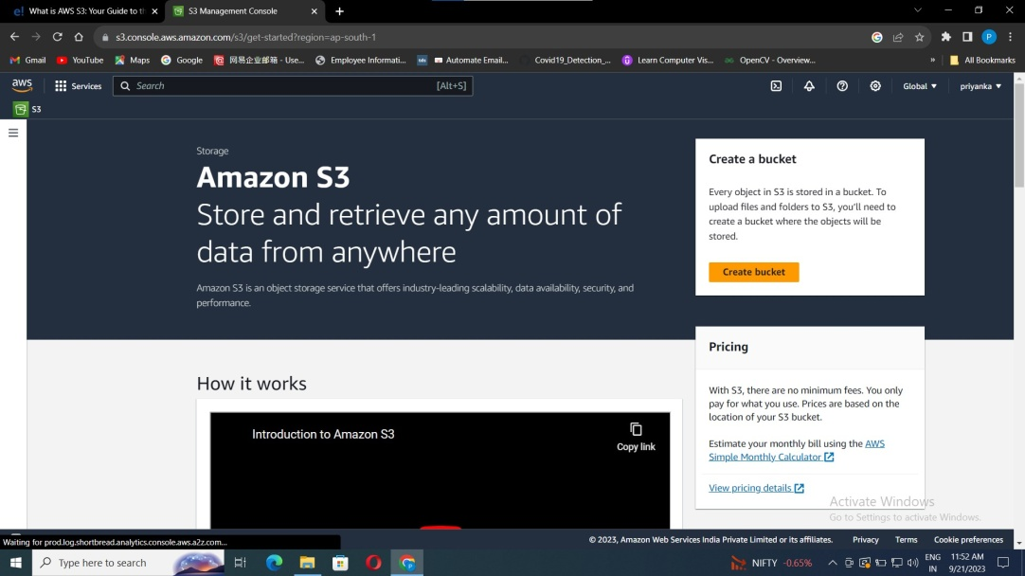
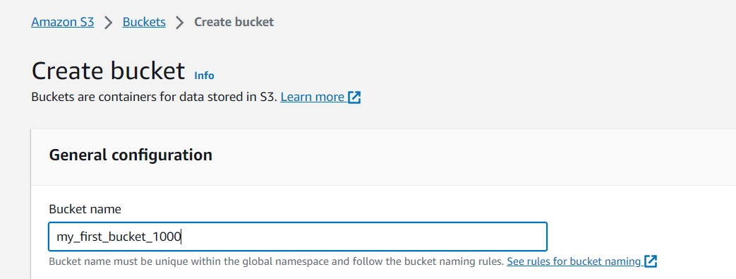
Click on create bucket.
Enter a bucket name.
Name given should be unique or else it will not be taken.

Slide 8
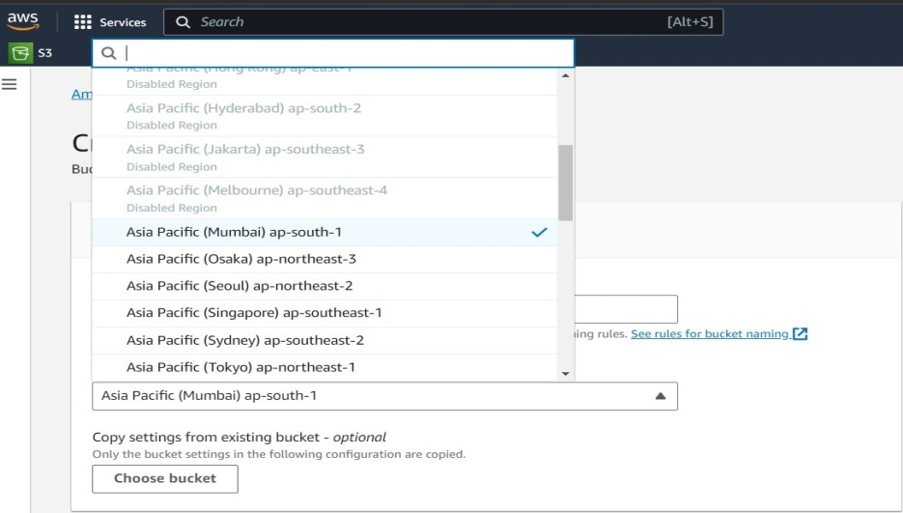
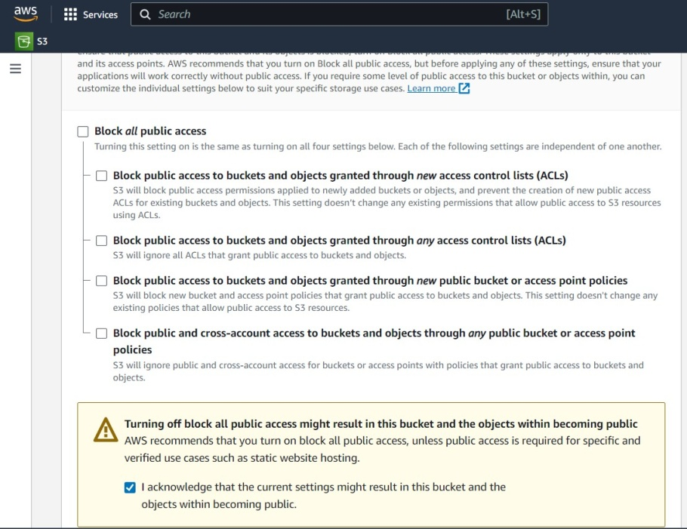
Select a specific region to store your data.
Unblock all public access and click the acknowledgement.

Slide 9
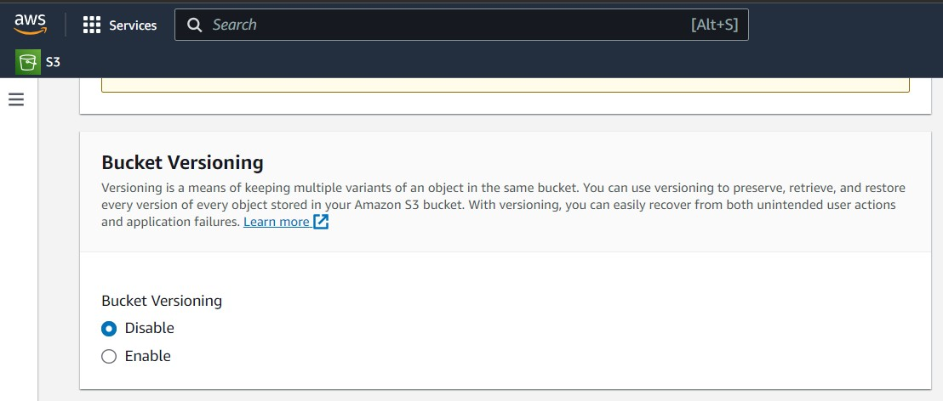
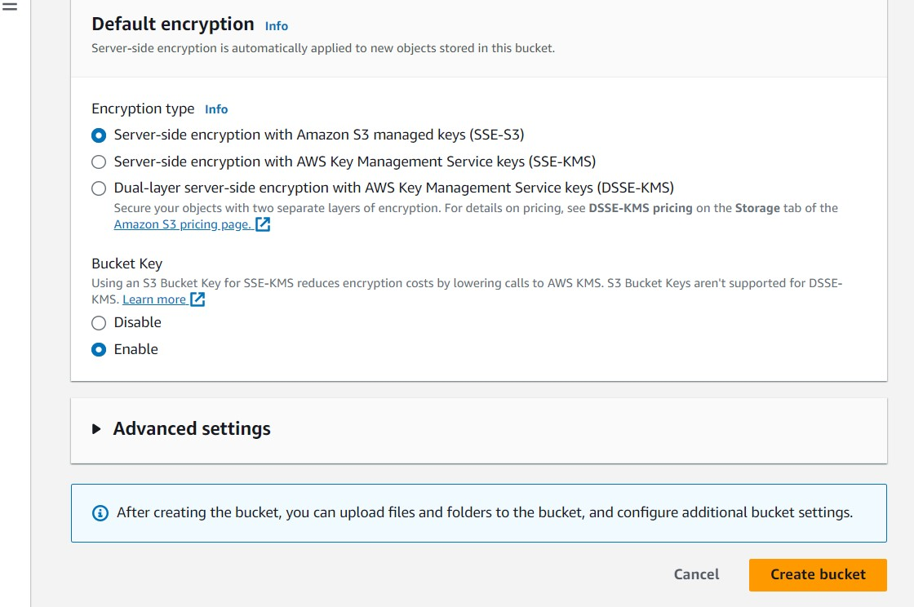
Disable the bucket versioning.
Keep all other settings as default, and click create bucket.

Slide 10
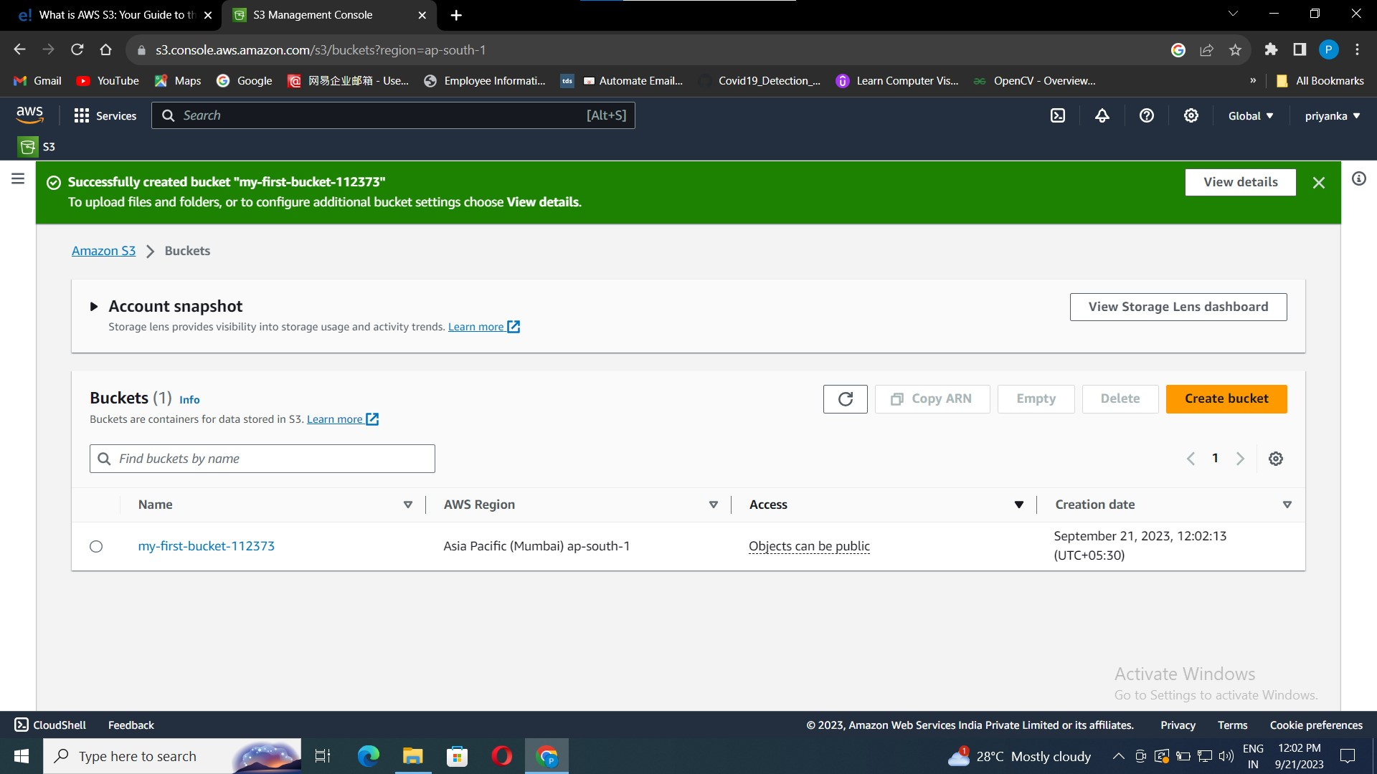
Your bucket is created successfully.

Slide 11
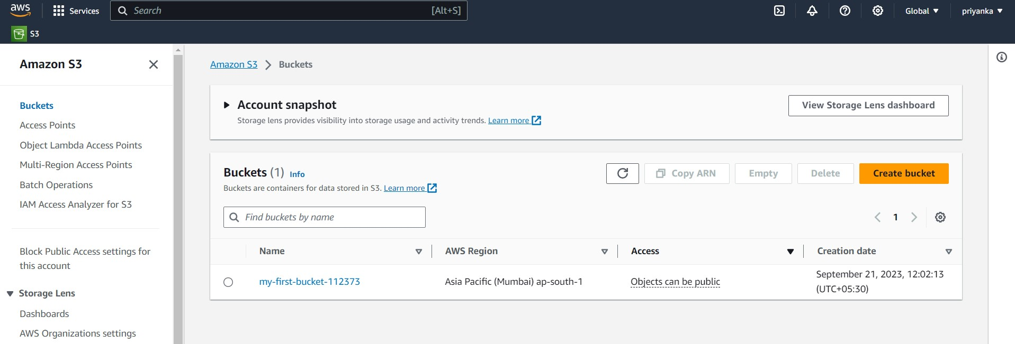
4. How to Upload object (data files) to your bucket
Now go back to the AWS S3 -> Buckets dashboard, you can find your bucket.
Click on the bucket name.

Slide 12
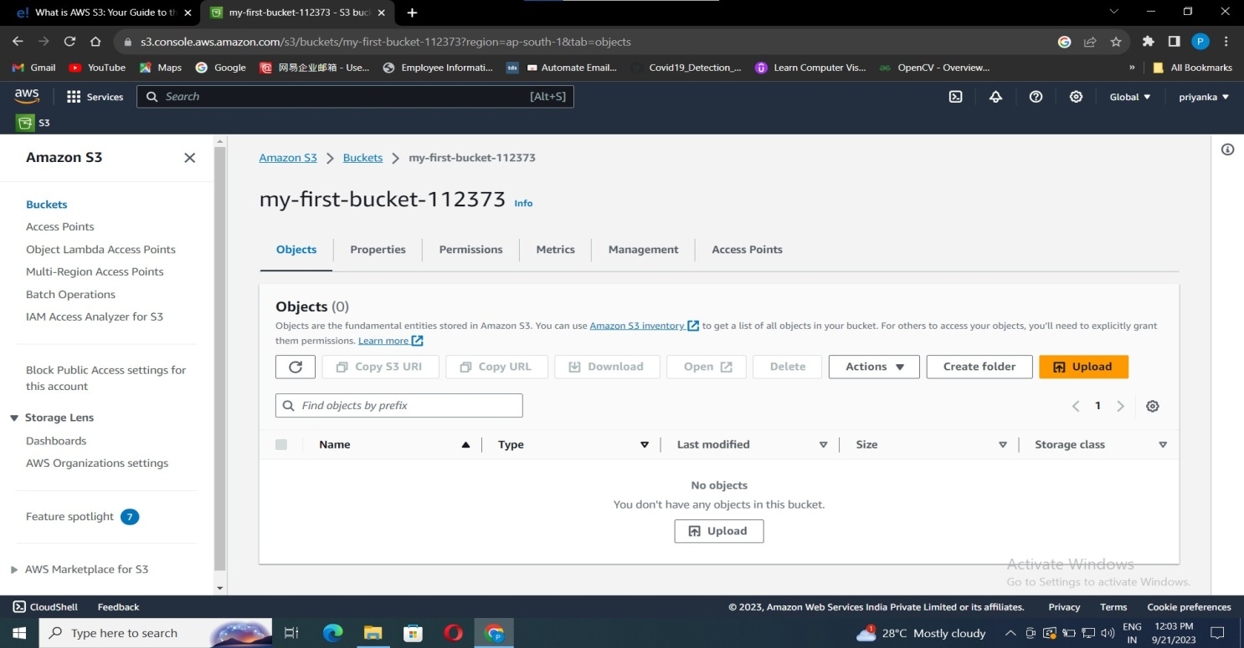
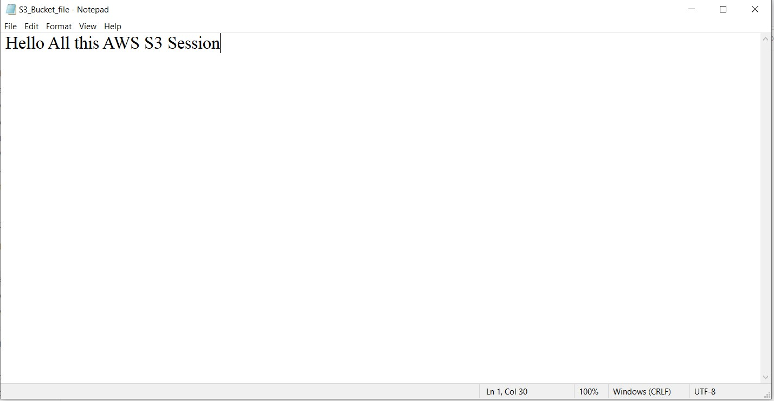
Click on upload button to upload your file.
I have created a text file in local pc, and named it as “S3_Bucket_file.txt” .

Slide 13
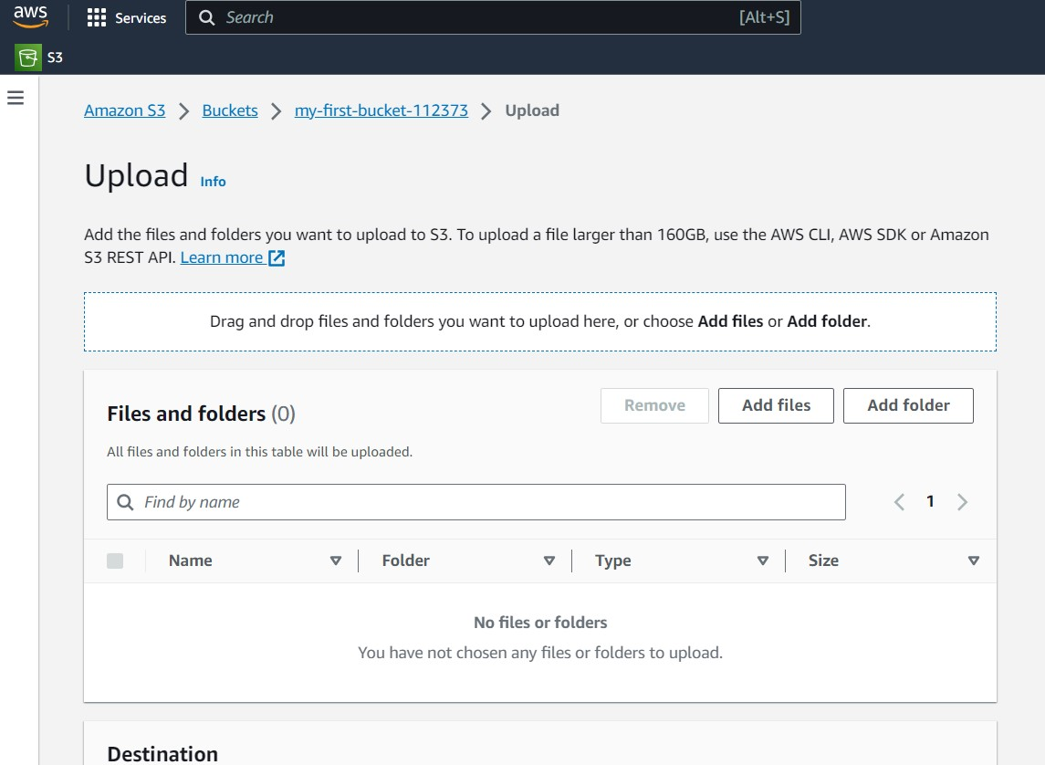
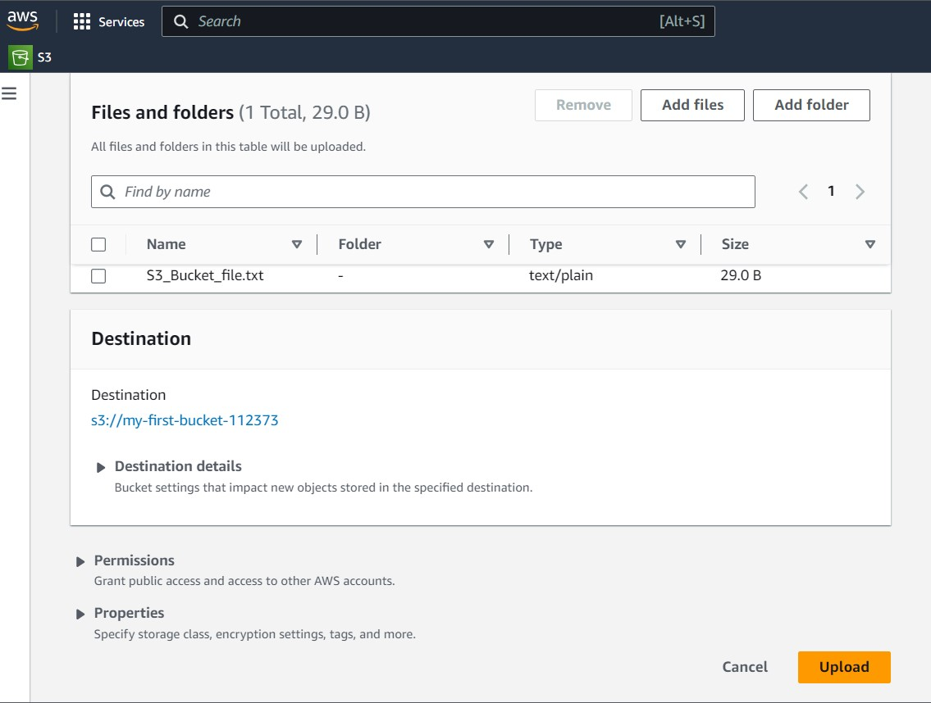
Click on Add file, browse created text file, and click on open.
Click on upload.

Slide 14
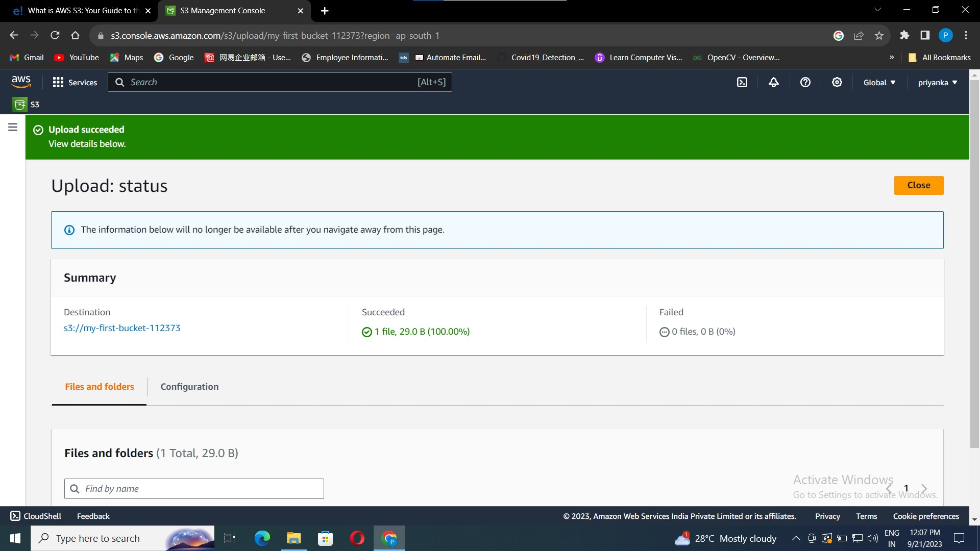
Your text file is uploaded successfully.

Slide 15
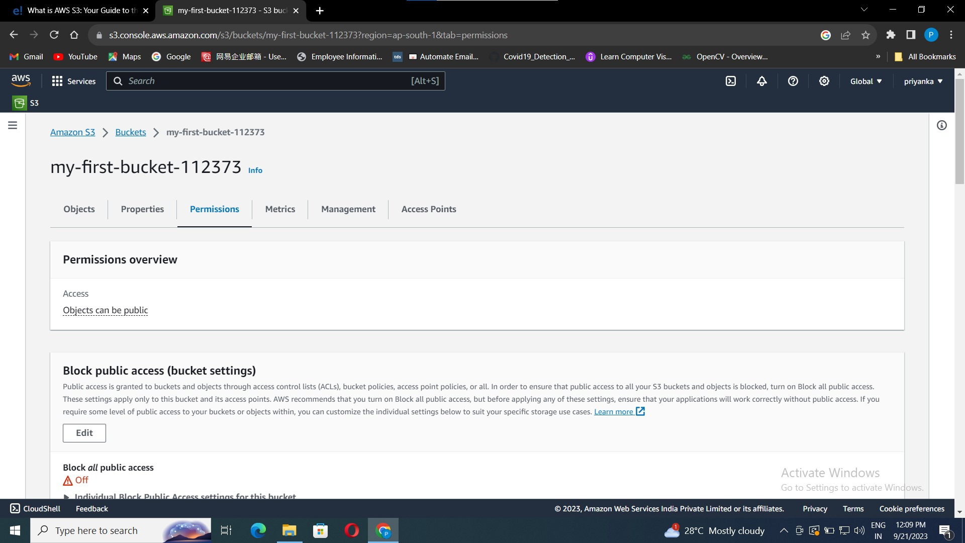
5. S3 data Accessing.
To access the data globally we need to set some permissions.
Go to S3 dashboard, click on bucket created, click “Permissions”.

Slide 16
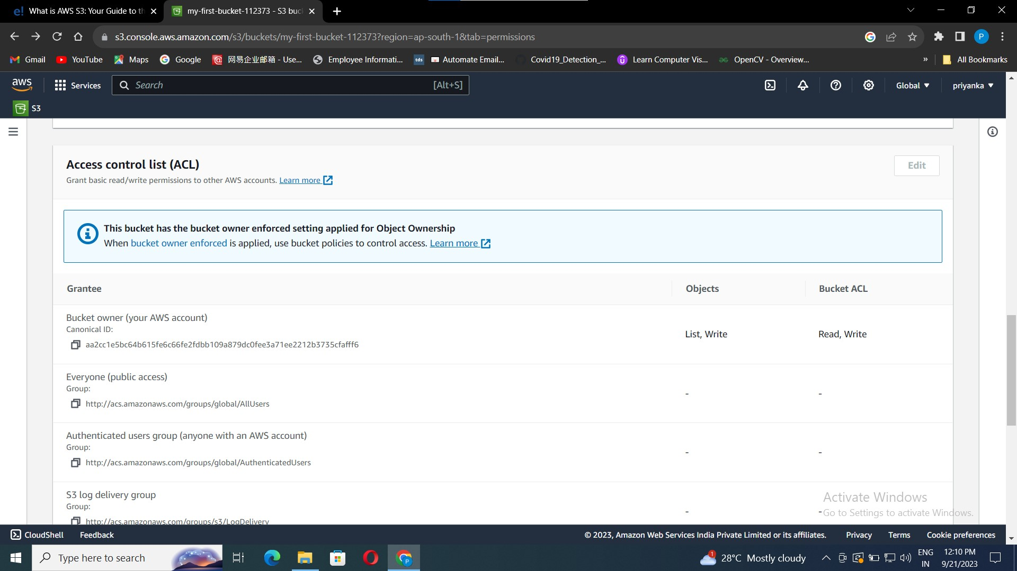
Go to Access Control list in permissions.
Click on “bucket owner enforced”.

Slide 17
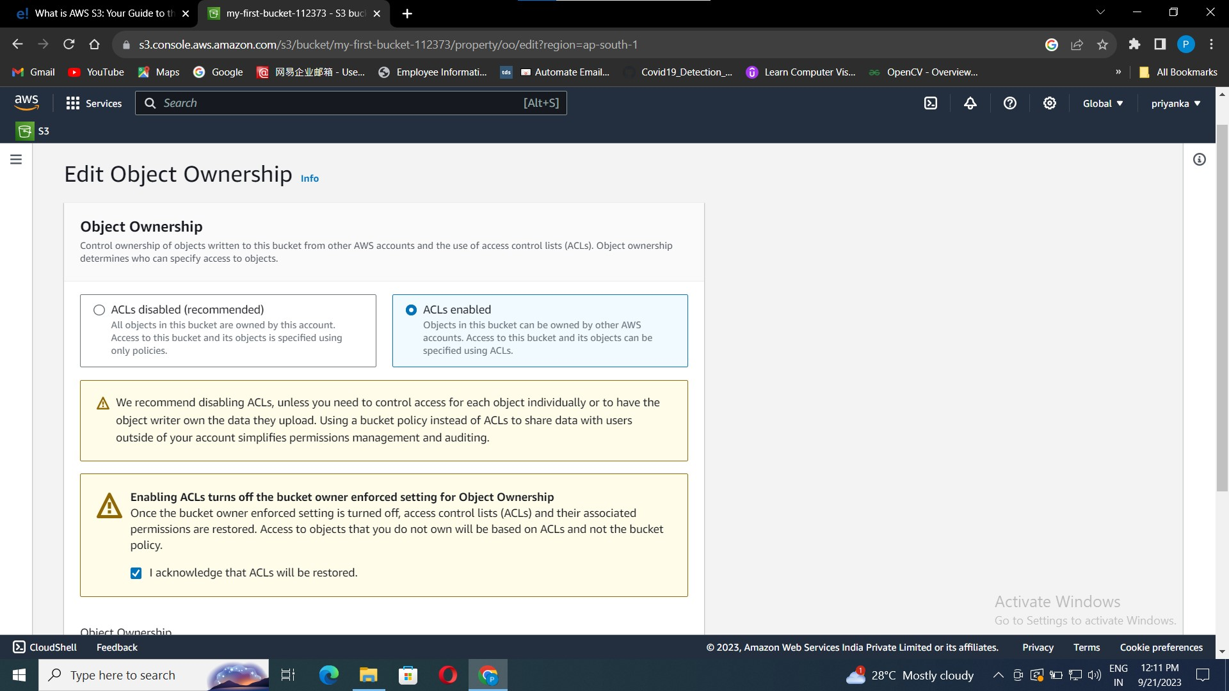
It will take you to the edit object Ownership dashboard.
By default ACL will be disabled, Select ACLs Enabled.
And acknowledge the ACLs, click edit changes.
Your changes are done successfully.

Slide 18
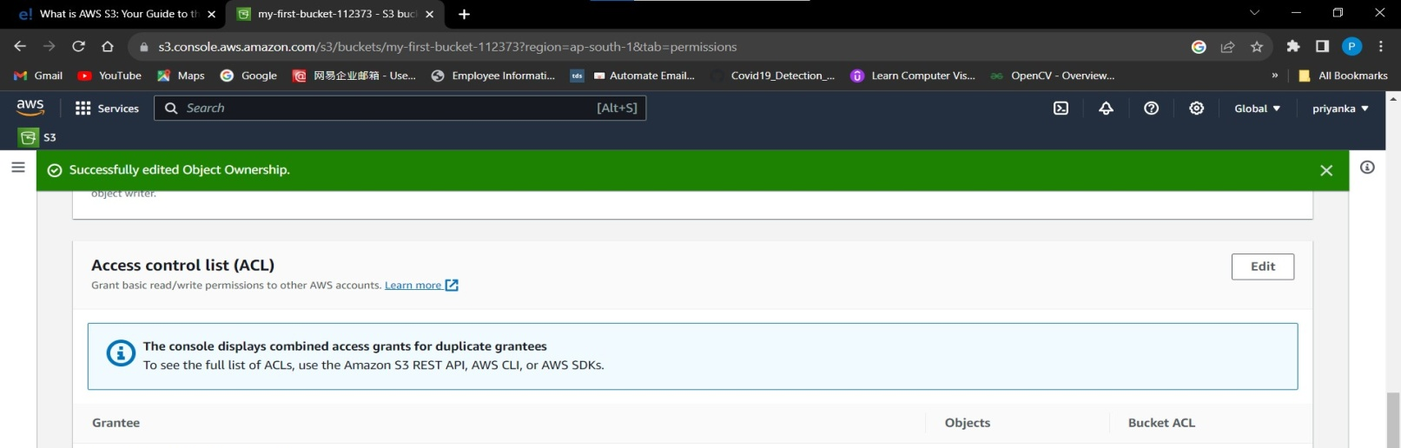
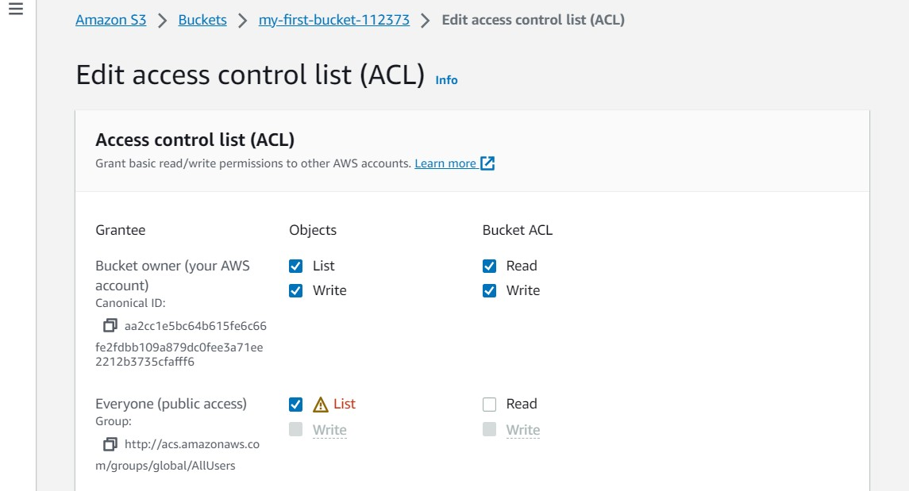
Now in ACL click on Edit button.
To give public access, click on list in Everyone, and click on edit changes.
Now your bucket is accessible to every one. Now to access your object you need to set the permissions for your object as well which is present in your bucket.

Slide 19
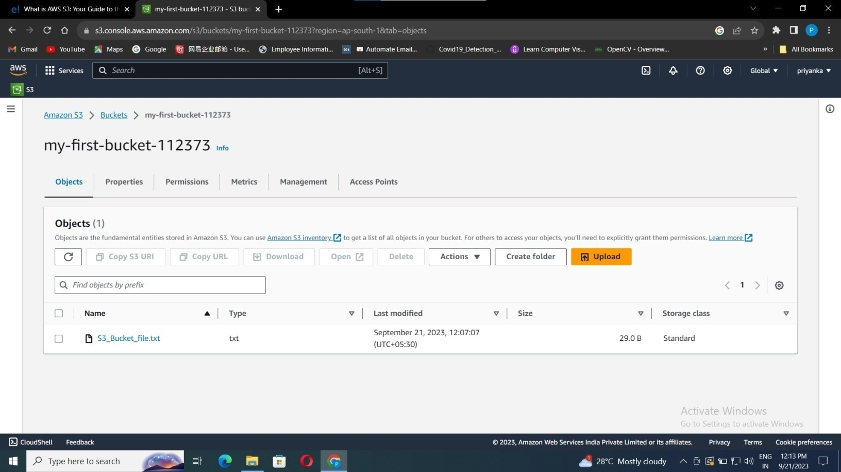
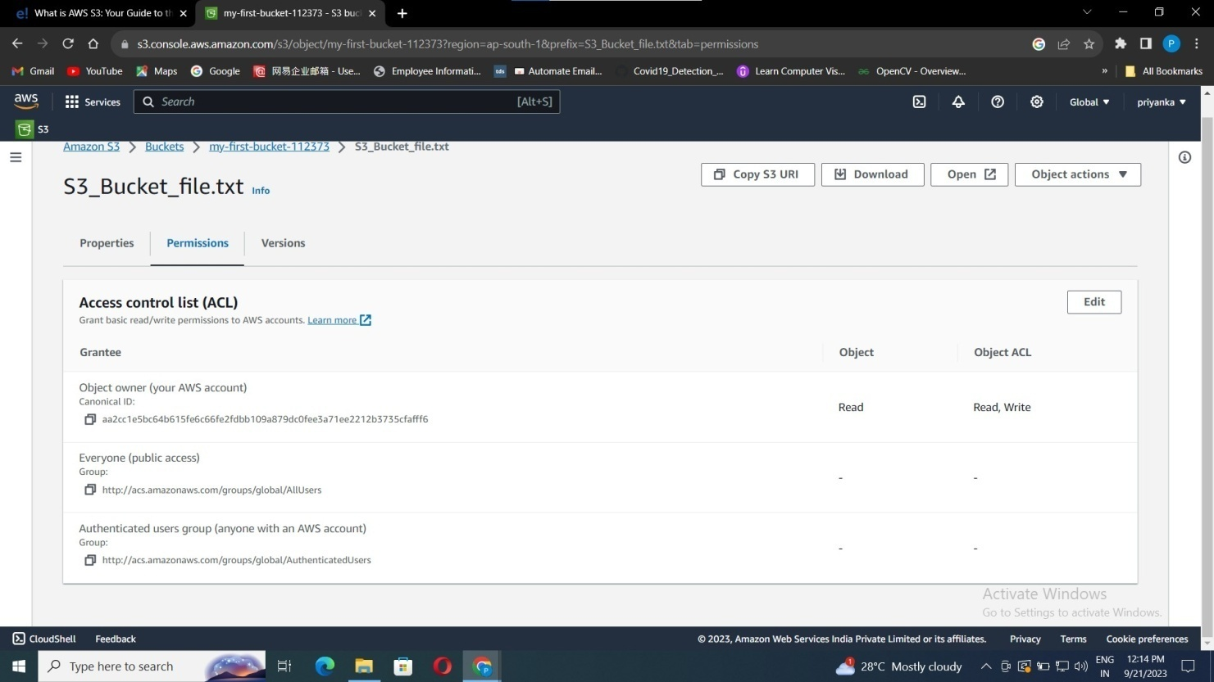
Go back to your created bucket click on your object that you uploaded.
Click on Permissions and click Edit button

Slide 20
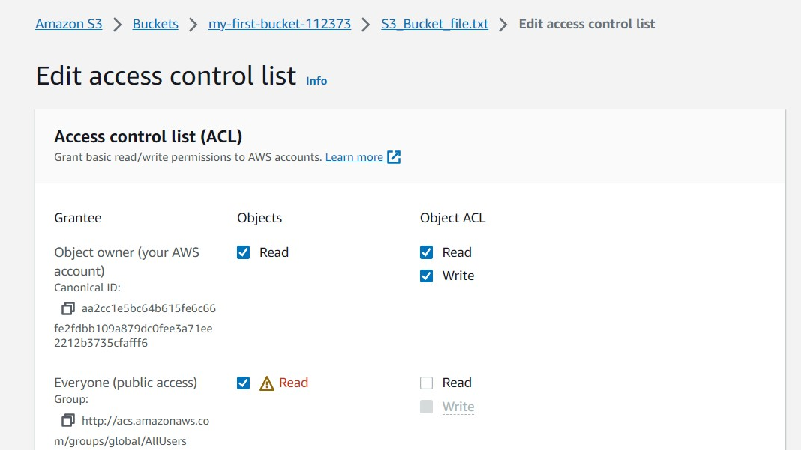
Give Read permission to everyone and save the info.
Now your data is ready to access publically.

Slide 21
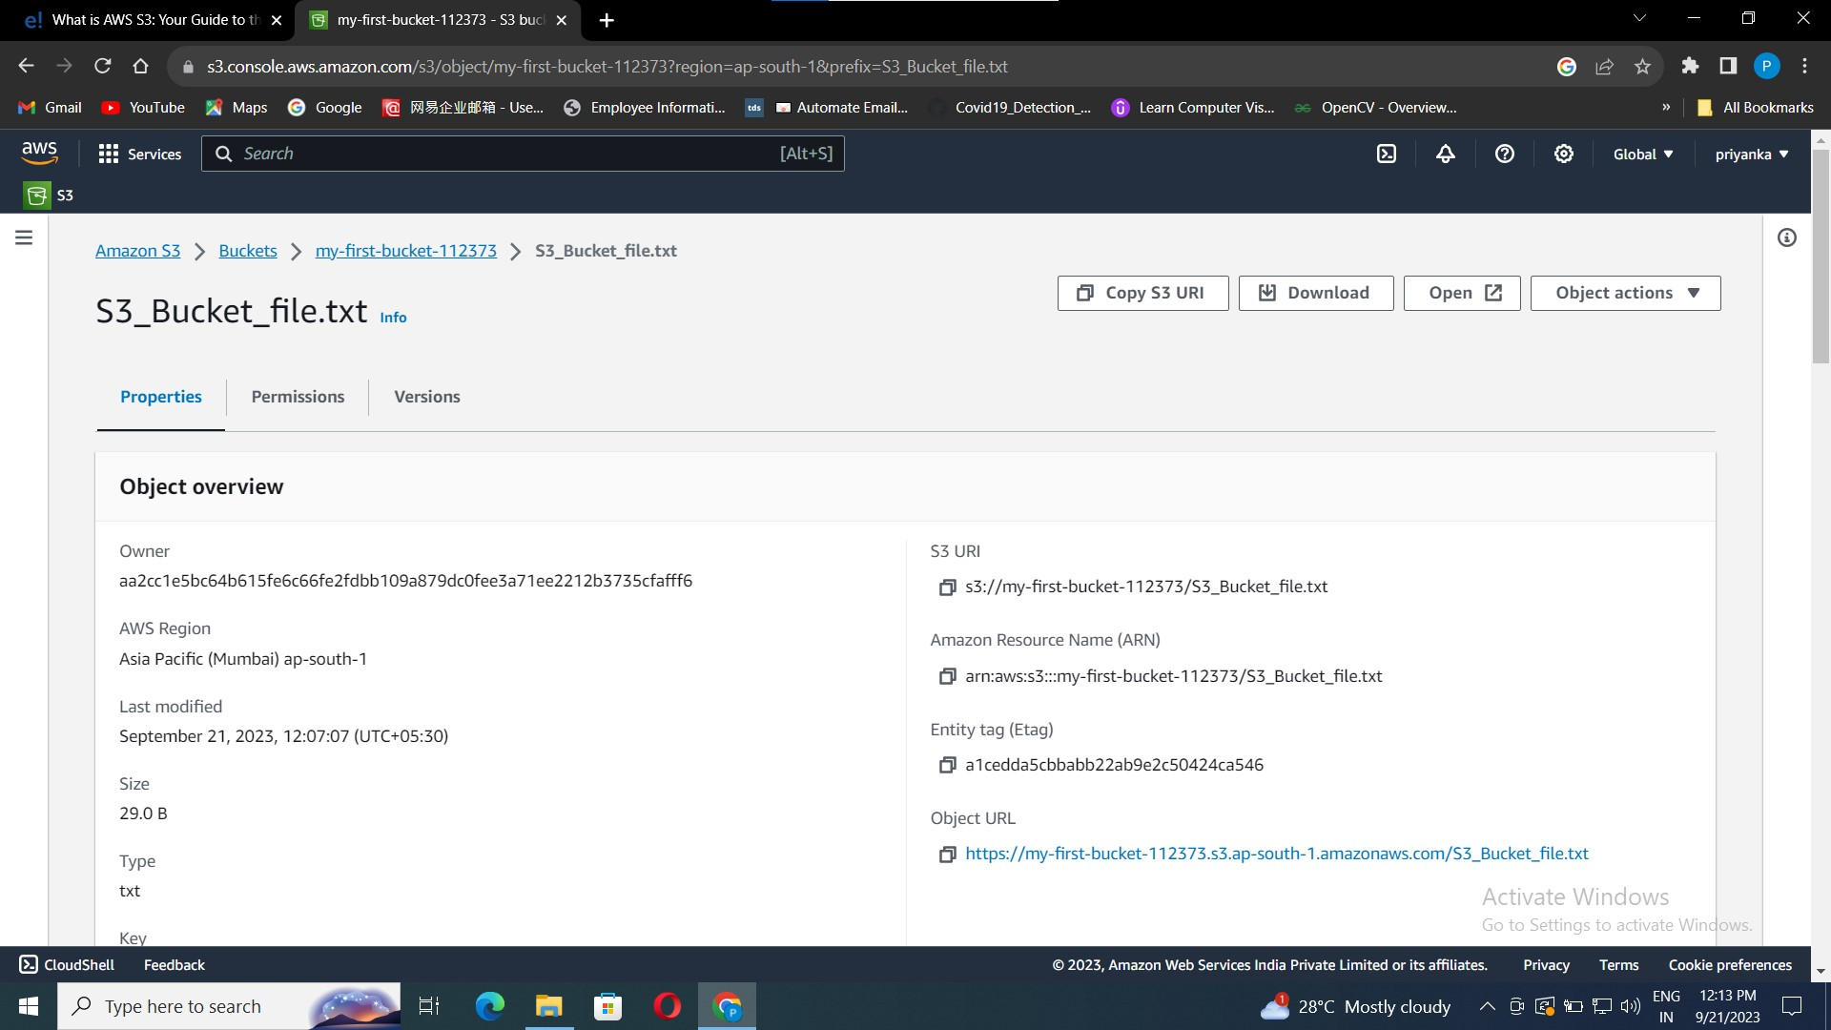
Now go back to the properties.
You can find object url, copy the url and pate it in any web browser.
Your data will be displayed.

Slide 22

The data in the text file is displayed.

Slide 23
6. S3 Life Cycle Management
An S3 Lifecycle Management in simple terms when in an S3 bucket some data is stored for a longer time in standard storage even when not needed. The need to shift this old data to cheaper storage or delete it after a span of time gives rise to life cycle management.
Why is it needed?
Assume a lot of data is updated in an S3 bucket regularly, and if all the data is maintained by standard storage it will cost you more(even if previous data is of no use after some time). So, to avoid extra expenses and to maintain data as per requirement only life cycle management is needed.
There are 2 types of actions:
Transition actions: Moving objects from one storage class to another storage class. Each storage class has a different cost associated with it.
Expiration actions: When objects expire after a span of time (say 30 days,60 days, etc). Amazon S3 deletes expired objects on your behalf.

Slide 24
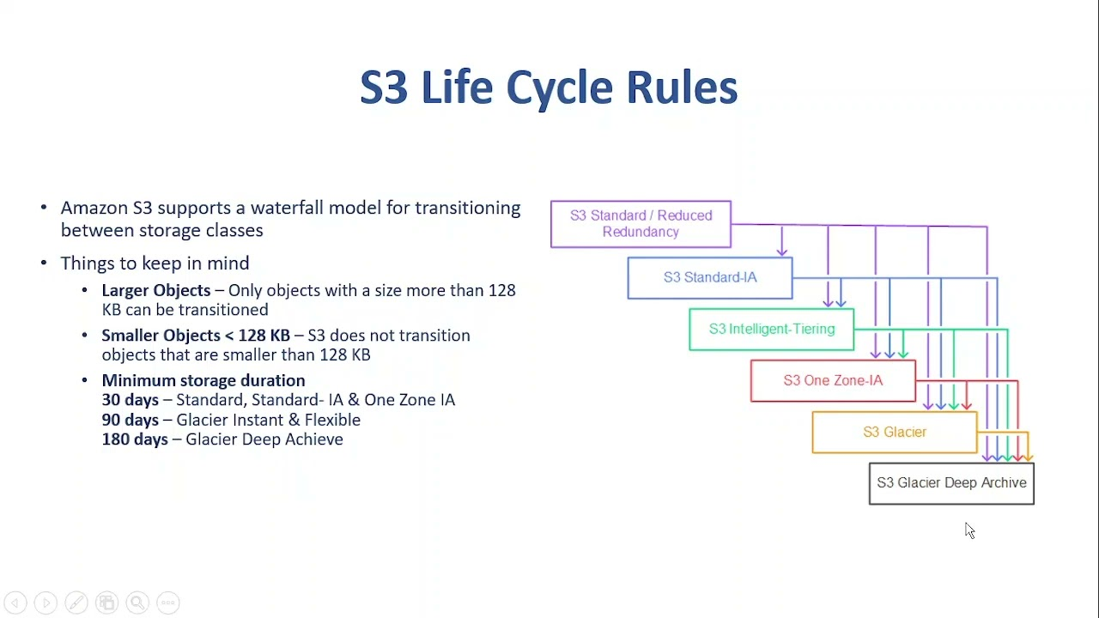

Slide 25
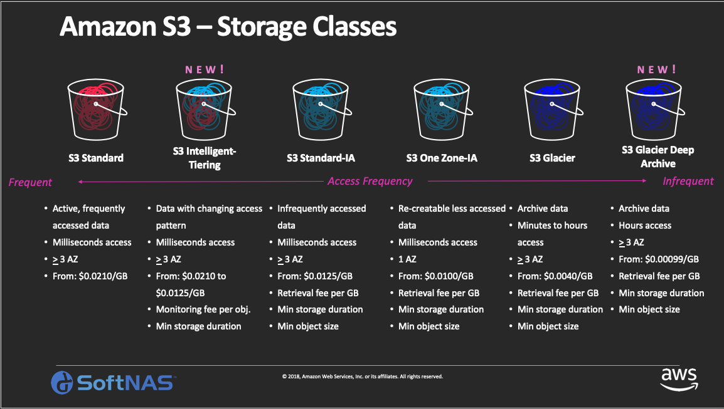

Slide 26
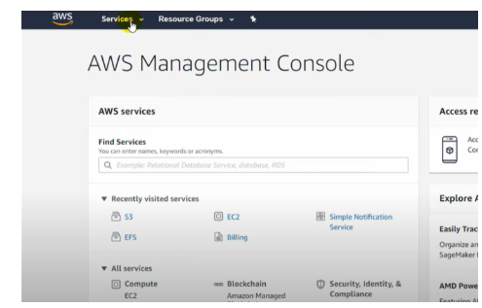
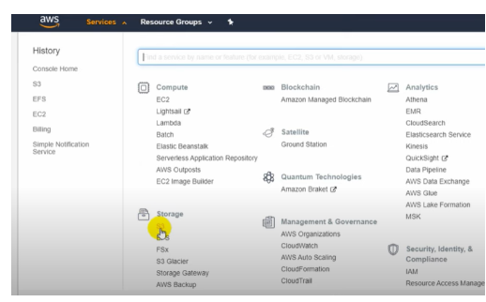
Implementation:
Follow the below steps to implement the S3 life cycle management:
Step 1: Login to your AWS, and go to services then under to S3.

Slide 27
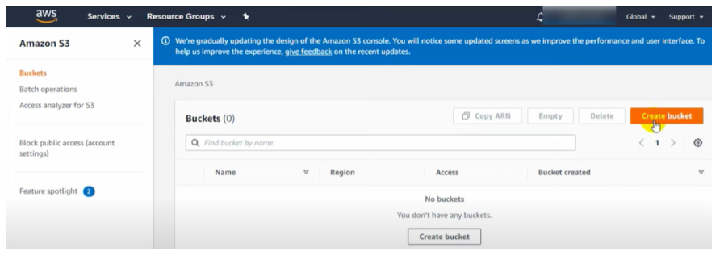
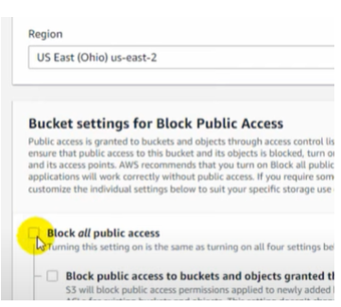
Step 2: Create a bucket, since applied to the bucket and not on a specific object or full storage.
Give bucket name(Try to give it a unique name else it will give an error later), uncheck the Block all public access. option.
Then check the “I acknowledge …” checkbox
and click on CREATE BUCKET

Slide 28
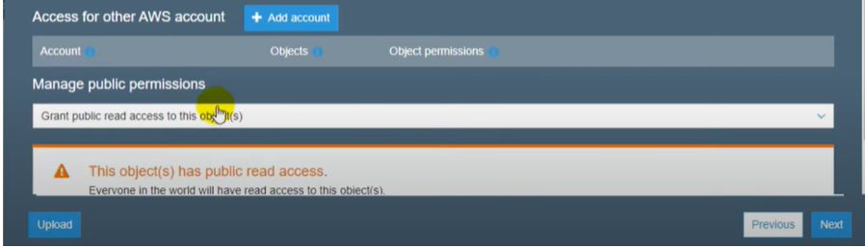
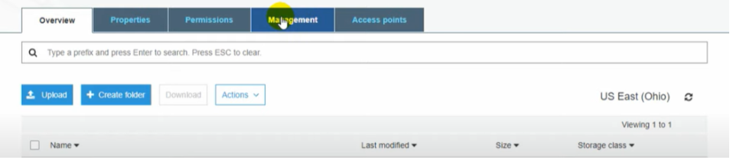
Step 3: Upload data into the bucket.
Step 4: Go back to your bucket, and go to “Management”.

Slide 29
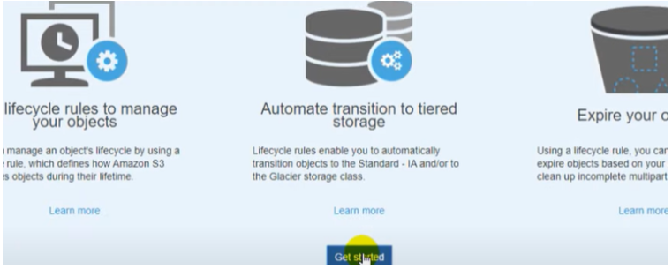
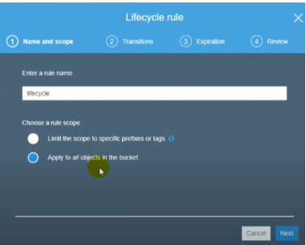
Click on “Get Started”.
Give life cycle name(need not be unique) and update settings.

Slide 30
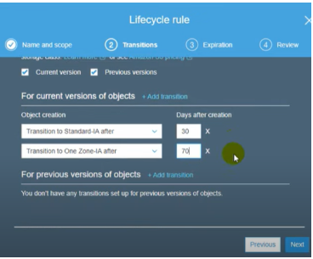
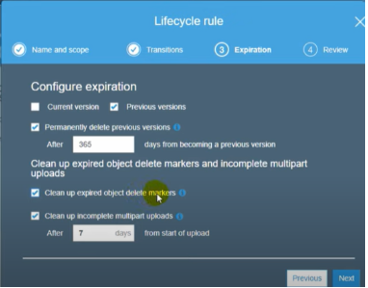
Add transitions(i.e. transferring data from standard storage to ones that cost less after a span of when data is no more useful. )
Do expiration settings (days after which data needs to be cleared from storage) and Save.

Slide 31
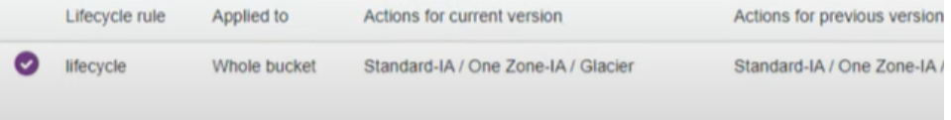
Step 5: Finally, an S3 bucket with LIFE CYCLE MANAGEMENT is created and will apply to all the data uploaded in the future.

Slide 32
7. Amazon Simple Storage Service(S3) – Versioning
It allows storing of different versions or forms of the object. Versioning makes it easier to preserve and roll back old updates of objects, whenever needed. Moreover, it helps to restore back the object from any unintended user activity such as deleting the object unintentionally.
S3 bucket available in three states depending on there state of versioning as following.
UnVersioned (default)
Versioning-enabled
Versioning-suspended.
UnVersioned (default):
Un-versioned state is the begining stage of an S3 bucket where all the objects which are stored in the bucket will remain unversioned means. This also called default state where if any updates are done to the objects in the bucket will get replaced by new bucket.
Versioning-Enabled:
This state is safest state to the object to be in if any updates or modifies happens S3 will store version of that update which means the older versions will remains same and the new version will be stored new unique ID.

Slide 33
Versioning-Suspended:
If you don’t want any new versions of an object to store in your bucket then you can suspend the bucket versioning. The new objects which are going to store in the bucket will not be versioned and the objects which are versioned will know be lost if you make any modifications.
How S3 Versioning Works?
S3 versioning helps you to maintain the different versions of the objects in an single bucket which you can keep an track of the objects like updated version and what the updates are made when compared to the previous objects. following are some of major changes will happen when the bucket is versioned.
If you want to store the updated version of object in the S3 bucket with out overwriting the current version of object stored in S3 bucket then bucket versioning will helps you to store different version by maintain the previous version .
The owner of the bucket will have all the authority to maintain the permission to the bucket by using AWS identity and access management(IAM).

Slide 34

Example of versioning:
Let the same example that we have done while uploading the object.
We have uploaded “S3_bucket_file.txt” in our created bucket.
Go to the aws login > S3 >buckets > click on bucket.
This is the file we have created and uploaded from our local pc.

Slide 35
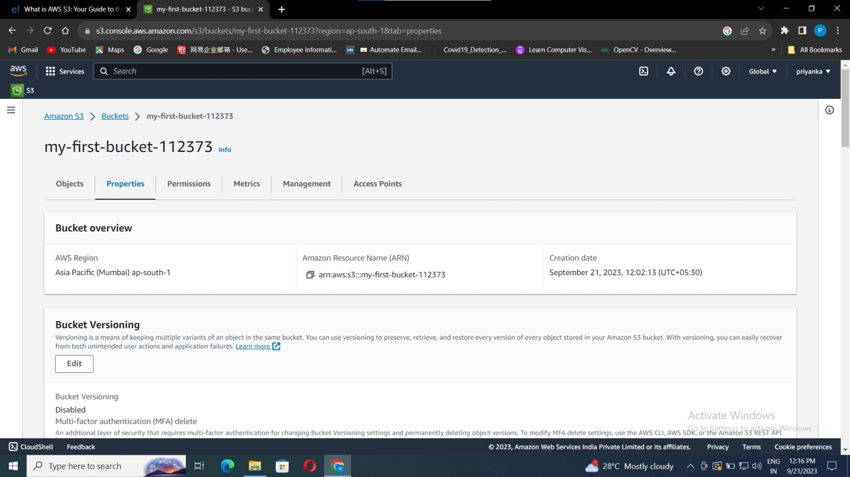
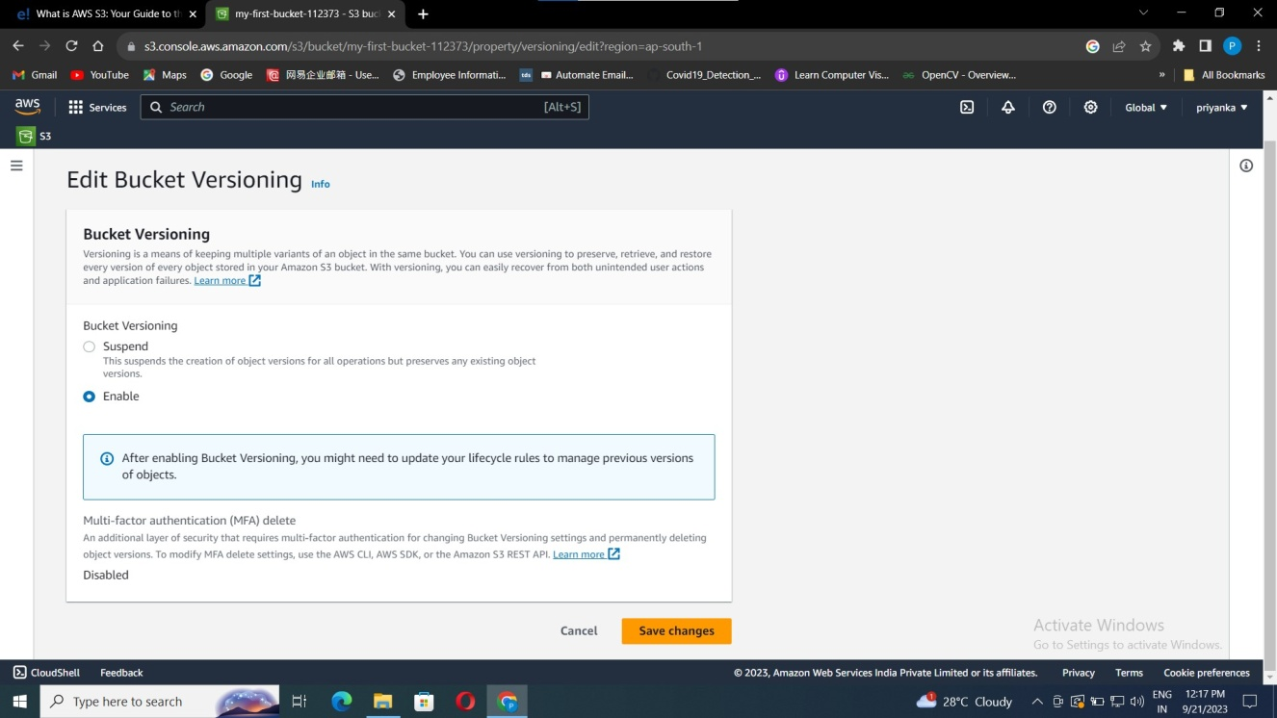
Go to the Properties, in Bucket Versioning click on edit button.
Choose option enable, and click on save changes.

Slide 36
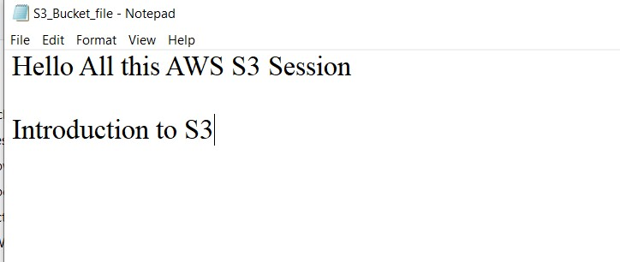

Now go back to the file in your local pc add some text and save it in the same text file that you have uploaded.
Now follow the upload steps that we have discussed previously.
Still you see that there is only file, its because the uploaded text file has same name as previous, we just updated the file with come content. So the previous file is replaced with the new file.

Slide 37
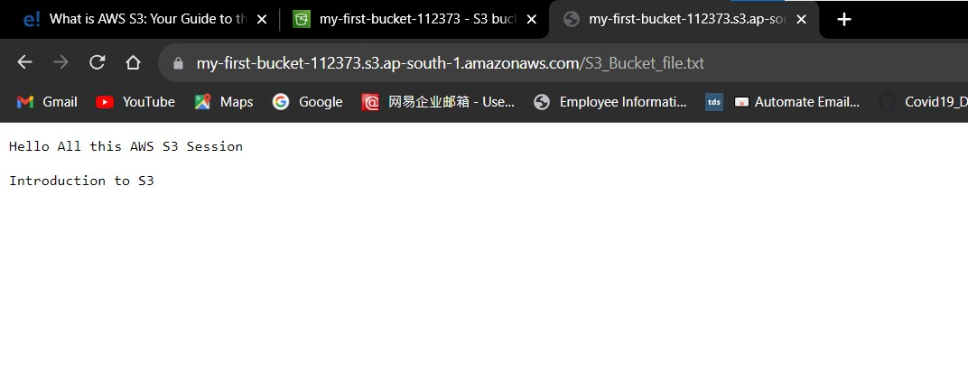
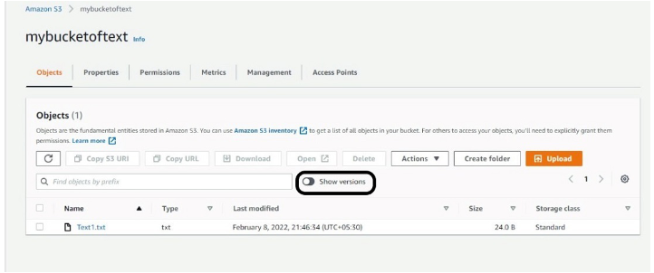
Now get the url as show in the previous session 4 “S3 data Accessing”.
Paste the url in any web browser you can find the updated data.
Now to get the previous content of the file or to roll back-Go to your created bucket>>Click on show version option>>You can find all your previous contents.

Slide 38
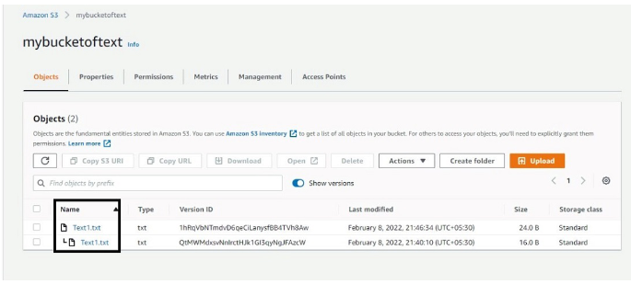
You can read or Download your previous version of your data.

Slide 39
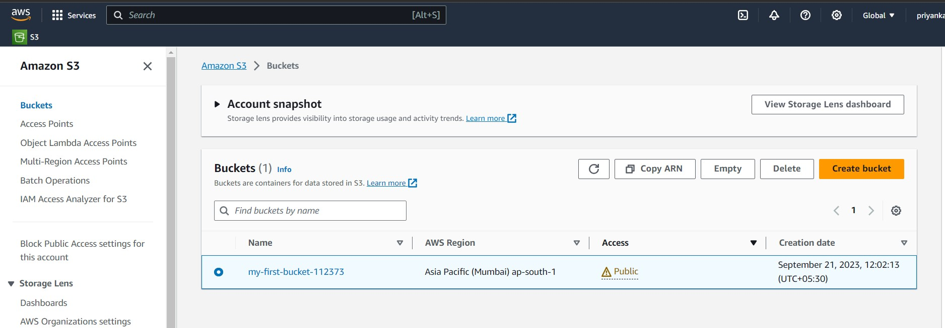
8. Deleting Bucket and objects.
Go to S3>Buckets.
Select the bucket.
Click on delete.

Slide 40
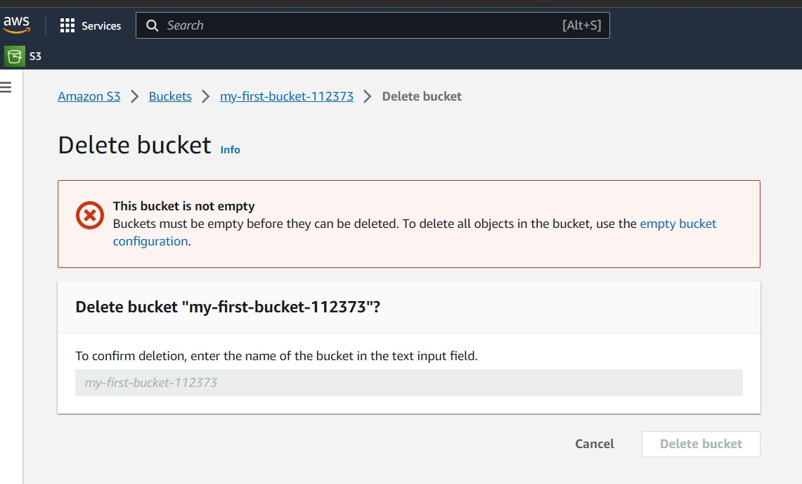
As it contains the objects in the buckets.
You need to 1st delete the objects.
Click on “empty bucket”.

Slide 41
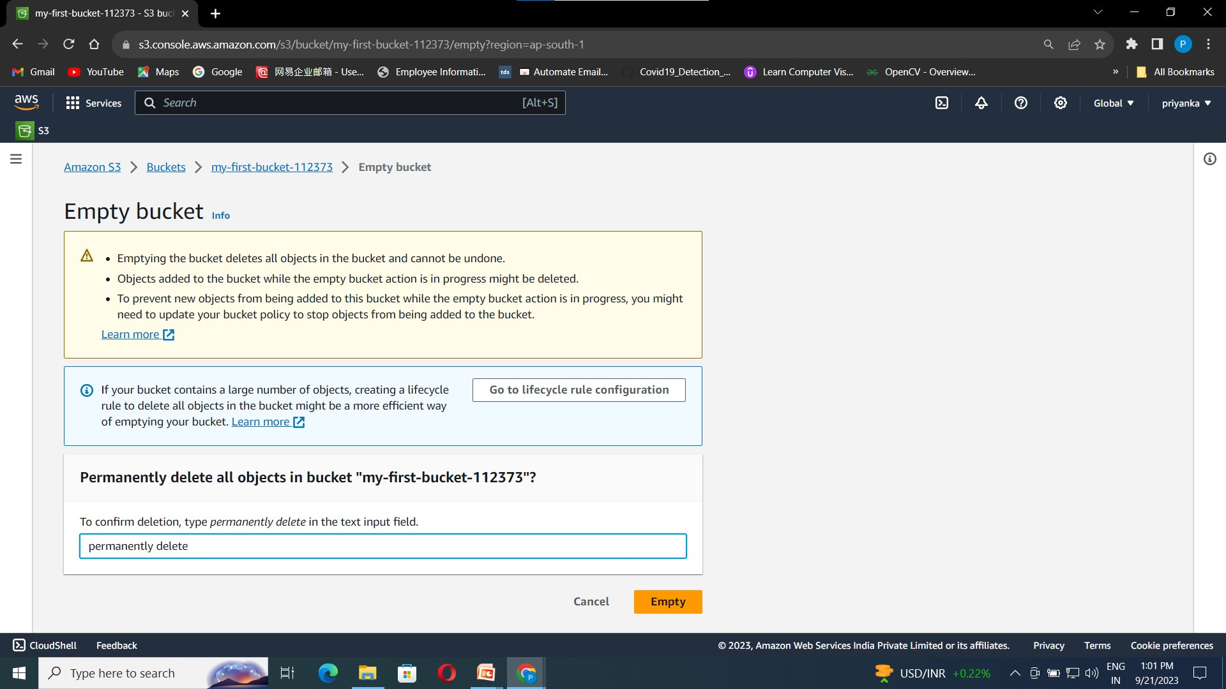
Enter “permanently delete”.
Click on Empty.

Slide 42
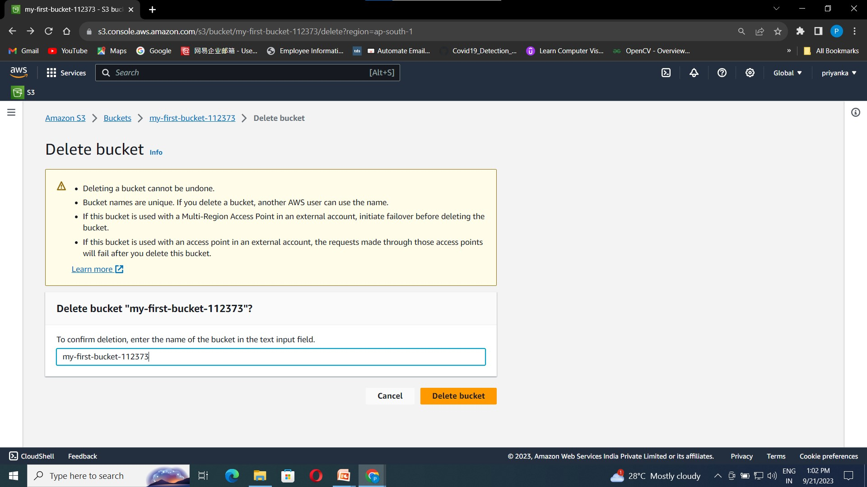
Now as there are no objects present in your bucket.
You can delete your bucket now.
Enter your bucket name and click on “Delete bucket”

Slide 43
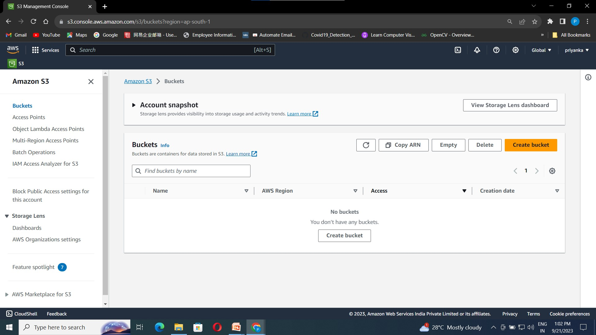
Your bucket is Successfully deleted.
Go back to your S3 bucket dashboard. You can see that there is bucket found that we have created earlier.

Slide 44
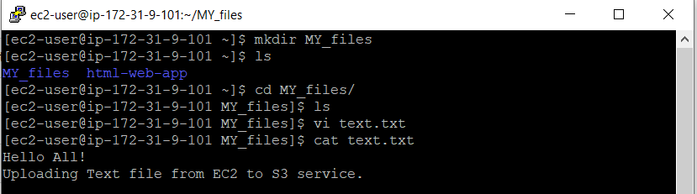
9. CLI commands for S3
Create a directory, and create text file in that directory.
Add some content in the text file using vi editor.

Slide 45
To upload the text from the local to the S3 server is as follows.
Syntax: “aws service_name cp file_name service_name://bucket_name/file_name”.
Example: “aws s3 cp text.txt s3://priyanka-vutkur-123445/text.txt”
This command copy’s the text file present in EC2 instance to s3 bucket
s3 –> serivice name.
text.txt -> fie_name.
cp-> Copy command.
priyanka-vutkur-123445 -> bucket name.

Slide 46
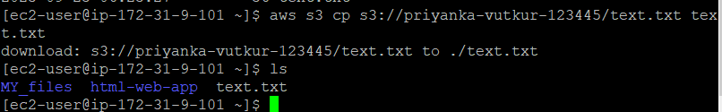

Downloading object from s3 to local.
Example: “aws s3 cp s3://bucket_name/file_name path_for_destination”
Creating Bucket.
Example: “aws s3 mb s3://bucket_name”
mb -> make bucket
cli commands for reference: https://awscli.amazonaws.com/v2/documentation/api/latest/reference/

